Slide 1
Getting Started with the Common Data Service
Notes:
This module introduces the Common Data Service for Apps (CDSA) and explains how it provides a standardized database schema for business data used by PowerApps, Flow and Dynamics 365. Student will learn how to import external data into the CDSA and how to build canvas apps to read and write records for standard entities such as accounts, contacts and activities. The module teaches students how to customize standard entities as well as how to create custom entities to accommodate specific business scenarios.

Slide 2
Agenda
Common Data Service Overview
Creating the CDS Database
Understanding Entities
Building Model-driven Apps
Developing with Solutions and Custom Entities
Importing Data into the CDS Database

Slide 3
What is Common Data Service?
Platform for building business applications
Business application categories include CRMs, ERPs, etc.
Provides common database for generalized business scenarios
Conforms to the Common Data Model (CDM)
What does Common Data Service provide?
Standard database schema of common business entities
Extensible design for extending and creating entities
Ability to leverage and build entity-specific views and forms
Ability to build entity-specific business logic
Ability to quick build apps by assembling entity components

Slide 4
Evolution of Microsoft Business Application Suite
Microsoft has acquired many software companies
Several acquisitions involved software that targets CRMs and ERPs
Microsoft evolved many software applications into Dynamics suite
Dynamics 365 represents evolution from on-premises to cloud
Navision
Microsoft Dynamics NAV
Axapta
Microsoft Dynamics AX
Dynamics 365
Great Plains
Microsoft Dynamics GP
Solomon
Microsoft Dynamics SL
Microsoft CRM
Microsoft Dynamics CRM

Slide 5
Birth of the Power Platform
Microsoft moved entity infrastructure out of Dynamics 365
CDS has infrastructure for building entity-based business solutions
Dynamics 365 is now a suite of products that sit on top of CDS
Custom solutions built on CDS by adding entities with UI and logic
CDS provides underling foundation of Power Platform
Power Platform
Dynamics 365
Custom Solution 1
Custom Solution 2
Common Data Service (CDS)

Slide 6
Common Database Model Schema
CDM defines set of entities available to all applications
Account: represents an business entity that can be invoiced
Contact: represents a human being
Activity: represents an event that can be schedule
Task: represents work item that can be assigned to user or team
Email: represents email message sent or received
User: represents system user who can be owner of records
CDS for Apps
Account
Contact
Activity
Task
Email
User

Slide 7
CDS versus Dynamics 365 for Sales
CDS provides base set of entities
Custom solutions extend CDS by adding custom entities
Dynamics 365 extends CDS by adding a large set of its own entities
Dynamics 365 Value-added Entities
Territory
Lead
Opportunity
Quote
Invoice
Order
Product
Price
List
Discount
Contract
Service
Service
Activity
Case
Case Resolution
Campaign
Campaign
Activity
Campaign
Response
Competitor
CDS for Apps Entities
Account
Contact
Activity
Task
Email
User

Slide 8
Agenda
Common Data Service Overview
Creating the CDS Database
Understanding Entities
Building Model-driven Apps
Developing with Solutions and Custom Entities
Importing Data into the CDS Database

Slide 9
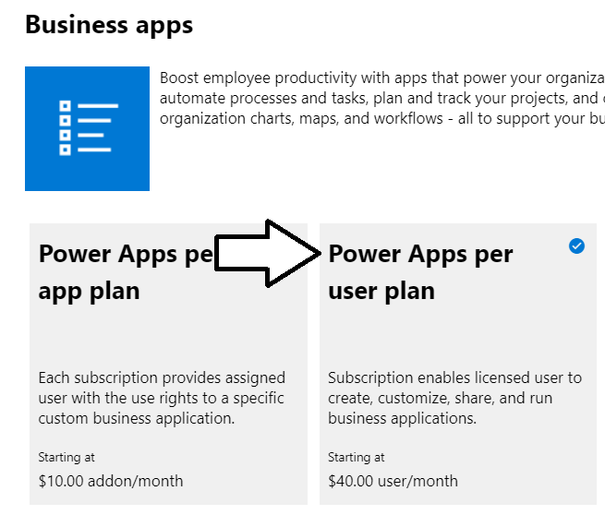
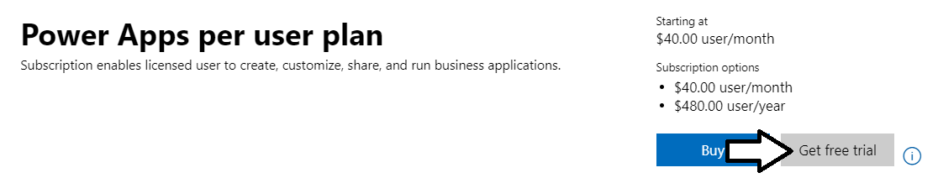
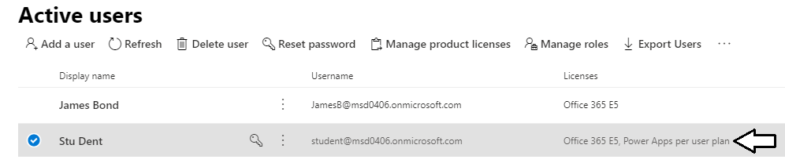
Getting a Power Apps Per User Plan
Certain design tasks require Power Apps per user plan
You can start a 30-day trial for Power Apps per user plan
License must be assigned to individual user accounts

Slide 10
What is an Environment?
Environment is container for apps, flows and a CDS database
Each environment and its resources exist within a geographic region
Environment represents a governance and security boundary
Every tenant is provisioning with a default environment
Administrator can provision additional environments if needed
Environment can be provisioned with or without a CDS database
Environment can contain only one CDS database
Tenant A – Contoso
Tenant B – Wingtip
Default Environment
POC Environment
Default Environment
Dev Environment
Prod Environment
Apps & Flows
Apps & Flows &
CDS Customization
Apps & Flows
Apps & Flows &
CDS Customization
Apps & Flows &
CDS Customization
CDS
Database
CDS
Database
CDS
Database

Slide 11
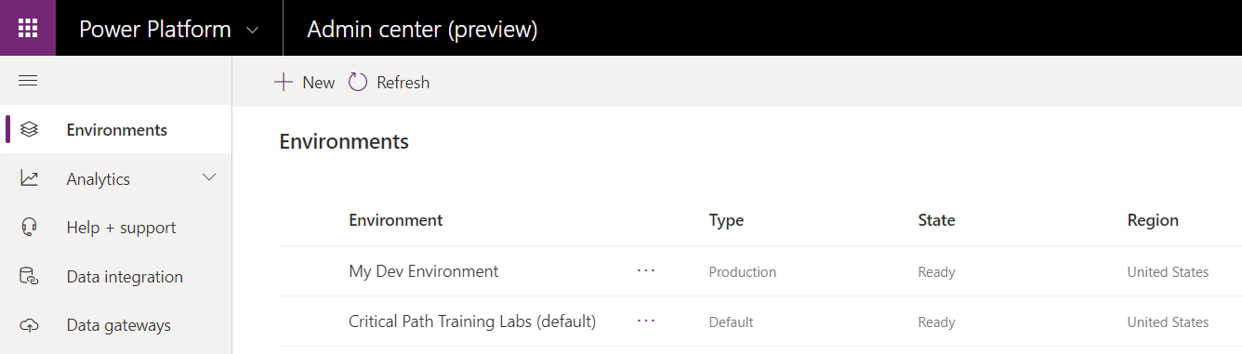
Power Apps Environments and the CDS
Environments managed in Power Platform Admin Center
You can configure security and access
You can create new environments

Slide 12
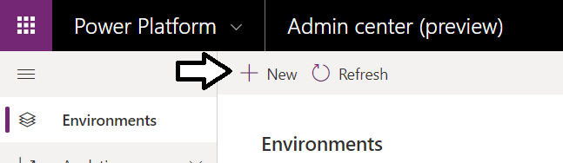
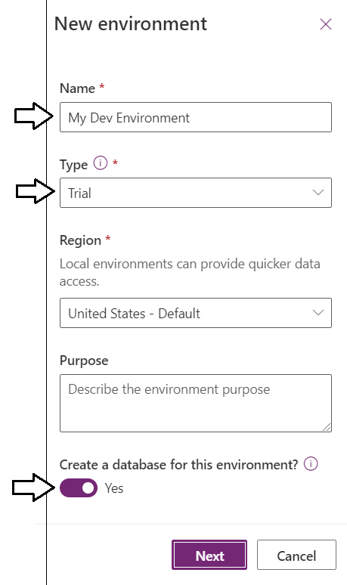
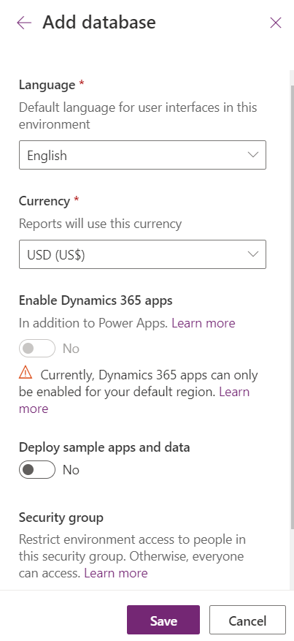
Creating Environment with CDS Database
Steps to create a new CDS for Apps Database
Navigate to Power Platform Admin Center
Create a new trial environment a CDS database As of January 2020, users with trial licenses can only create trial environments

Slide 13
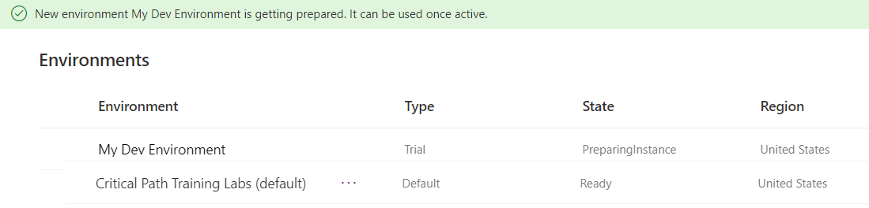
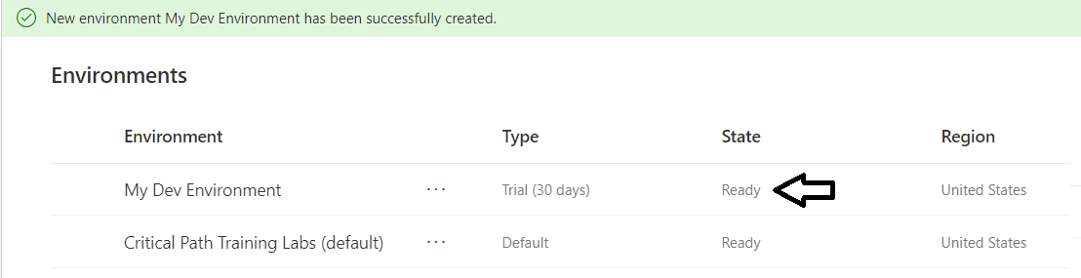
Examining the New Environment
It takes a minute or so to create new environment
You can use the environment once its status is Ready

Slide 14
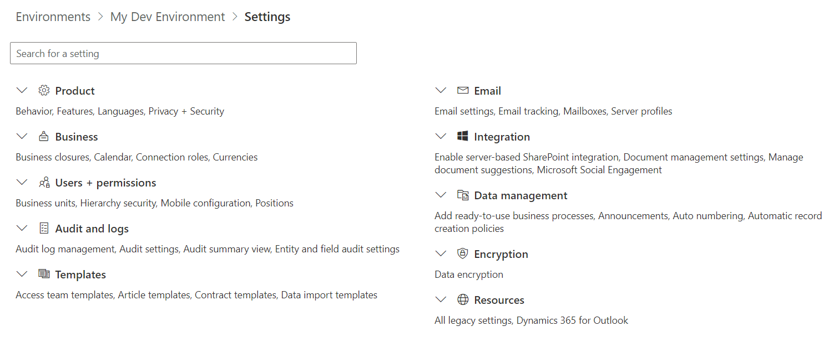
Environment Settings
Power Platform Admin Center provides configuration
Each environment has its own Setting page
Provides many environment configuration otpions

Slide 15
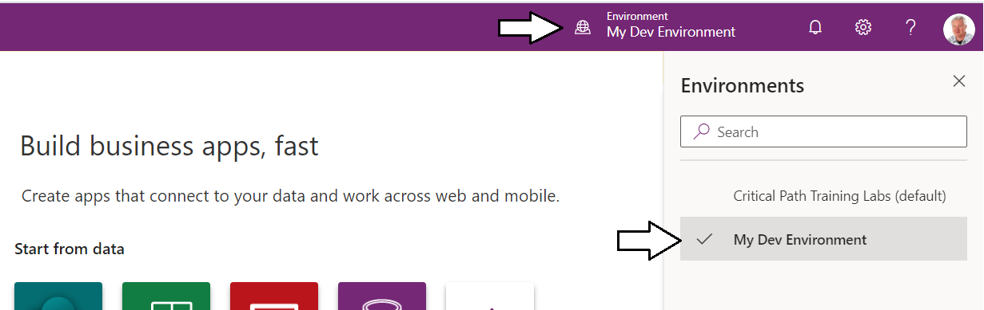
Navigating Between Environments
Power Apps Maker Portal provides Environment menu
It’s located at top right of page in the Power Apps maker portal
Environment menu used to navigate between environments

Slide 16
Creating a new Environment with a CDS Database

Slide 17
Agenda
Common Data Service Overview
Creating the CDS Database
Understanding Entities
Building Model-driven Apps
Developing with Solutions and Custom Entities
Importing Data into the CDS Database

Slide 18
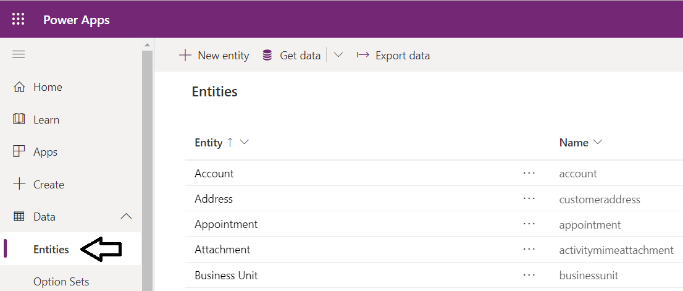
Inspecting the Standard Entities
CDS created with set of standard entitles

Slide 19
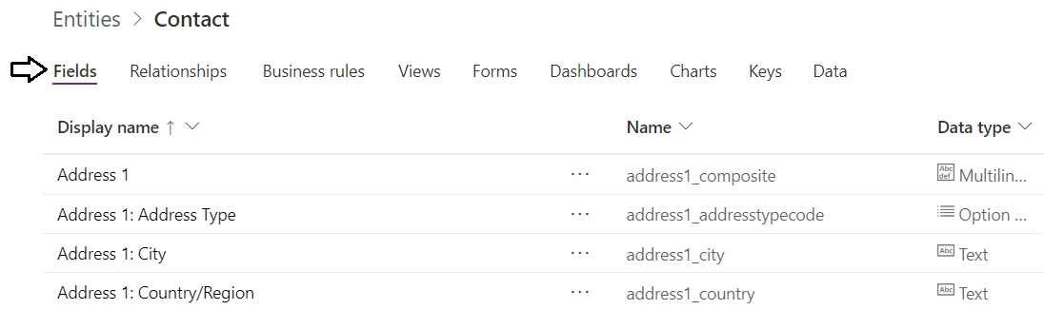
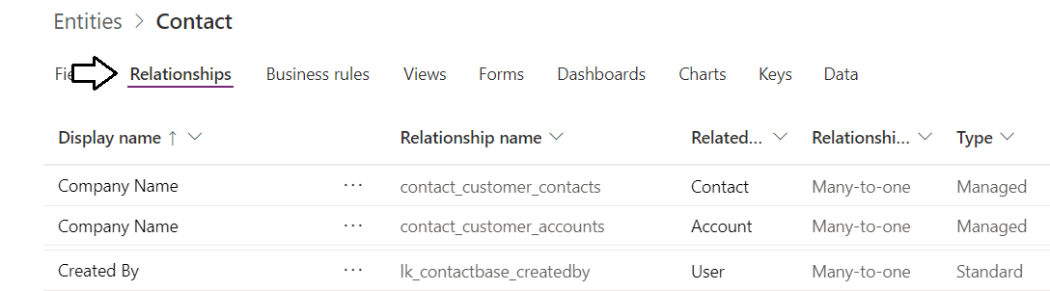
Entity Fields and Relationships
Entity contains fields which define data schema
Entity defined with relationships to ensure data validation

Slide 20
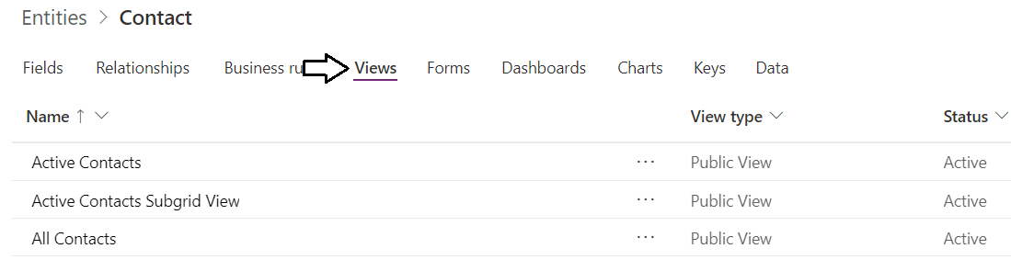
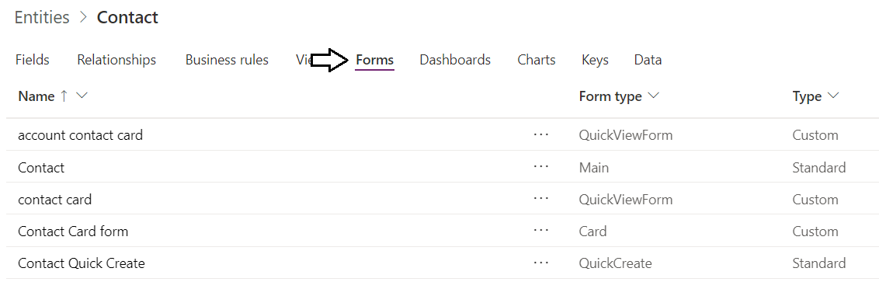
Entity Views and Forms
Entity contains views for displaying multiple records
Entity contains forms for viewing/editing single record
Forms and Views provide UI for model-driven apps
There is no way to leverage forms and views from canvas apps

Slide 21
Building a Canvas App to Read and Write Contacts

Slide 22
Agenda
Common Data Service Overview
Creating the CDS Database
Understanding Entities
Building Model-driven Apps
Developing with Solutions and Custom Entities
Importing Data into the CDS Database

Slide 23
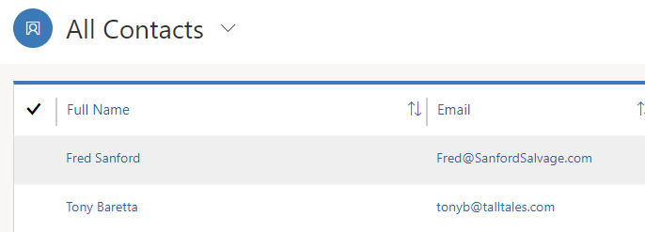
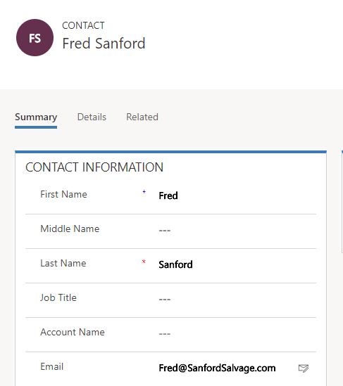
Comparing Model-driven Apps to Canvas Apps
What are the key benefits of model-driven apps?
You leverage entity views and forms - no need to build screens
Create apps with consistent UI navigation, elements & metaphors
Create responsive apps that can target tablets and mobile devices
CDS Entity View
CDS Entity Form

Slide 24
Model-driven App Components
Model-driven app
Top-level collection of components
Tracks fundamental app properties, client type, and app URL
Site map
Provides navigation component across other UI components
Entity views
Read-only view of records for a specific entity
Defines display columns, column width, sort behavior and filters
Entity forms
Provides set of data-entry controls for fields in a specific entity

Slide 25
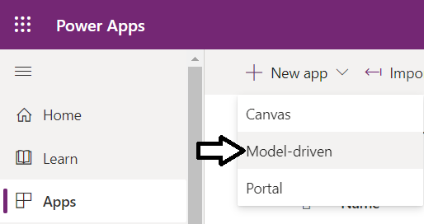
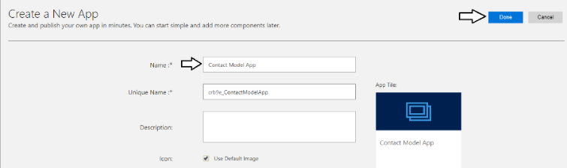
Creating a Model-driven App

Slide 26
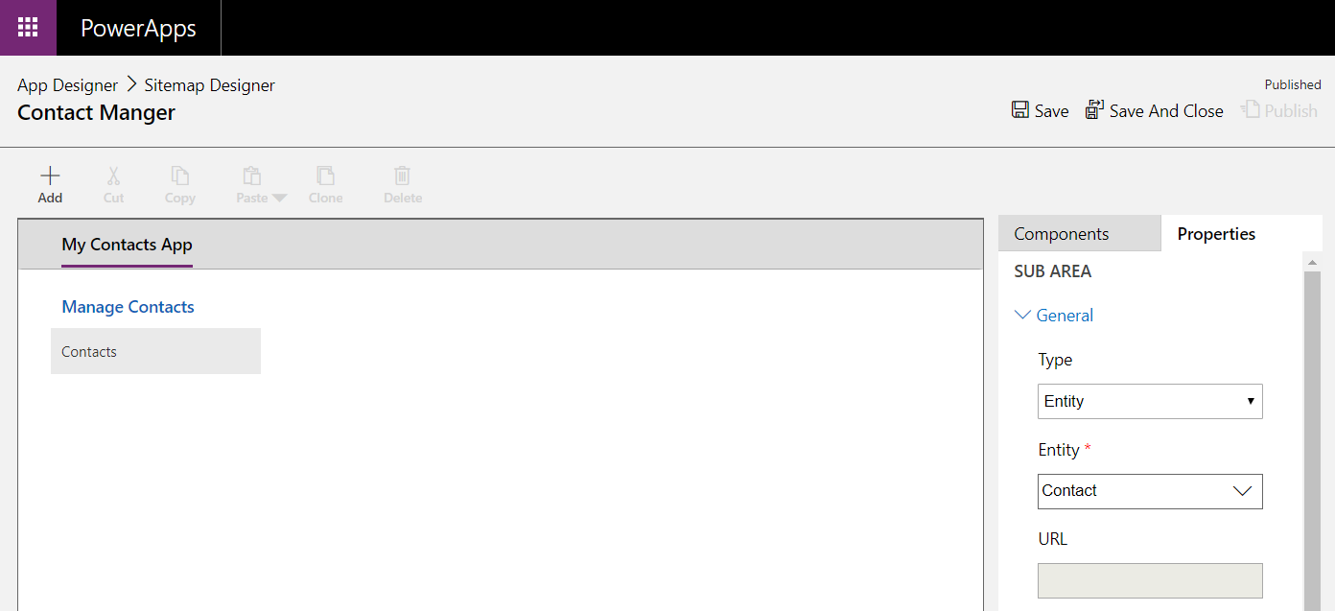
Creating the Sitemap Component

Slide 27
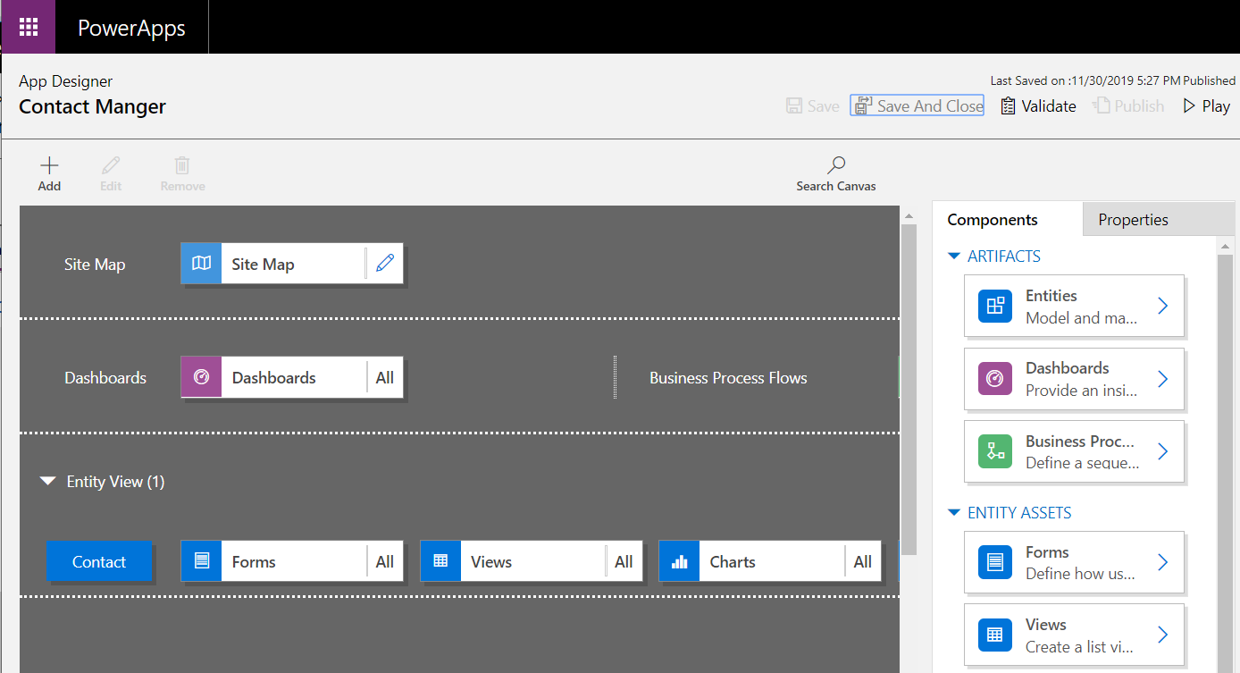
Publishing and Running the App

Slide 28
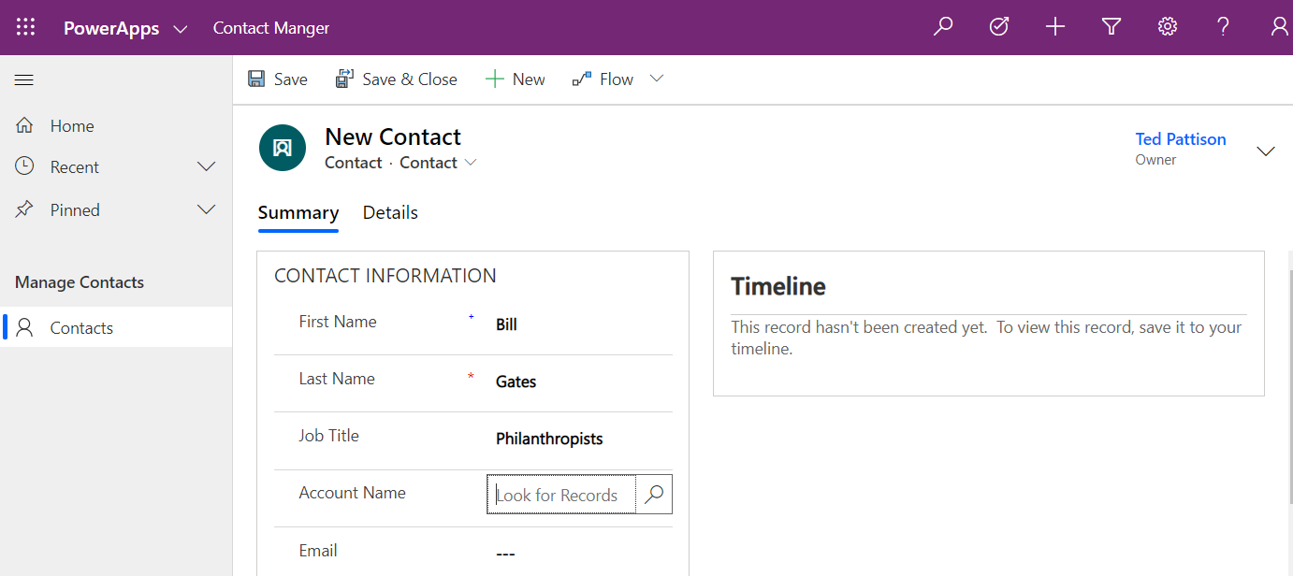
Testing a Model-driven App

Slide 29
Creating Model-driven Apps

Slide 30
Agenda
Common Data Service Overview
Creating the CDS Database
Understanding Entities
Building Model-driven Apps
Developing with Solutions and Custom Entities
Importing Data into the CDS Database

Slide 31
Understanding CDS Solutions
Solutions used to move applications between environments
Solutions used to package apps, flows and CDS customizations
Solutions not used to move business data itself
Solutions can be exported/imported as managed or unmanaged
Unmanaged solutions is "open" solution which allows changes
Managed solutions can be locked down to disallow changes
During development, you work with an unmanaged solution
When exporting a solution, you choose between managed or unmanaged

Slide 32
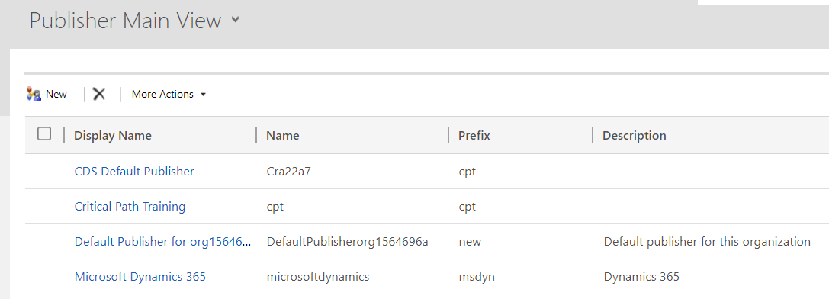
Publishers and Solutions
CDS solutions used to distribute applications
Used to conduct robust application lifecycle management (ALM)
Define a Profile for a CDS Publisher
Profile used to provide identity of developer of CDS solutions
You should create new publisher profile when developing solutions
Publisher profile contains prefix used in component names

Slide 33
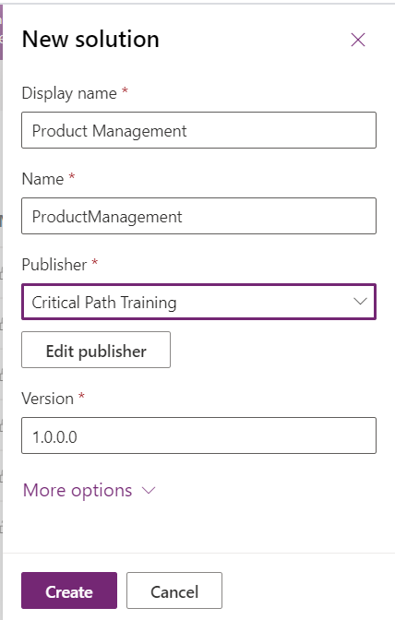
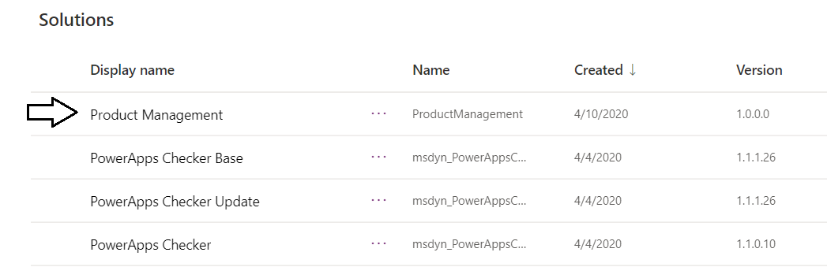
Creating a New CDS Solution

Slide 34
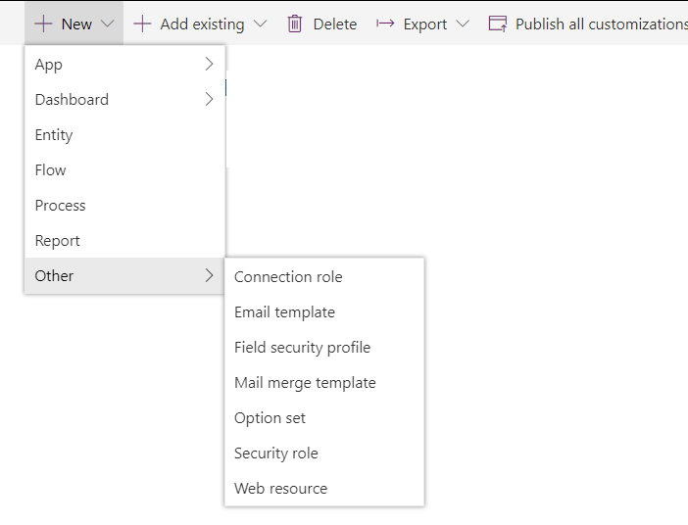

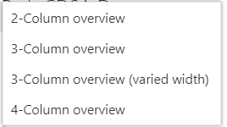
Adding Solution Components

Slide 35
Creating a New CDS Solution

Slide 36
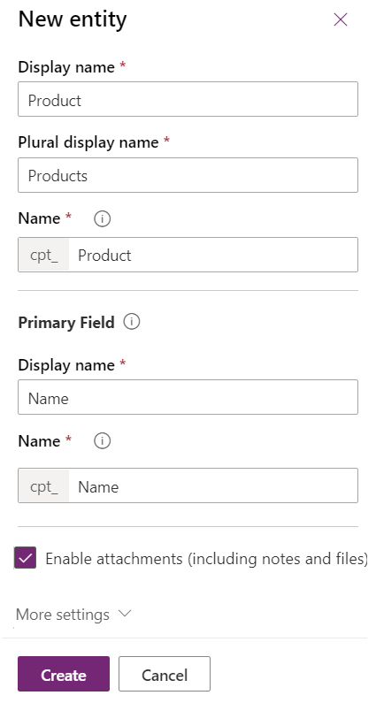
Developing a Custom Entity

Slide 37
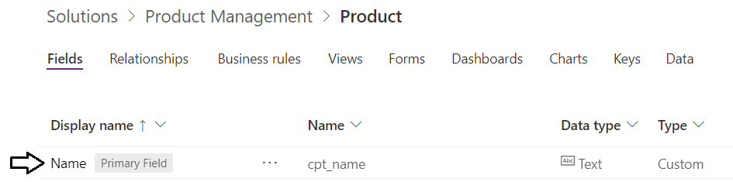
Primary Field
Every new custom entity created with a Primary Field
Primary field given a default name of Name
Similar to the Title site column in SharePoint list
Display name of primary field can be changed if appropriate

Slide 38
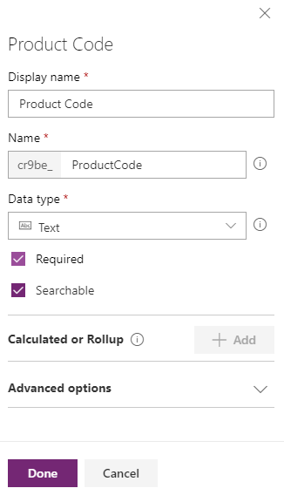
Adding Fields
Custom entity can be extended by adding fields

Slide 39
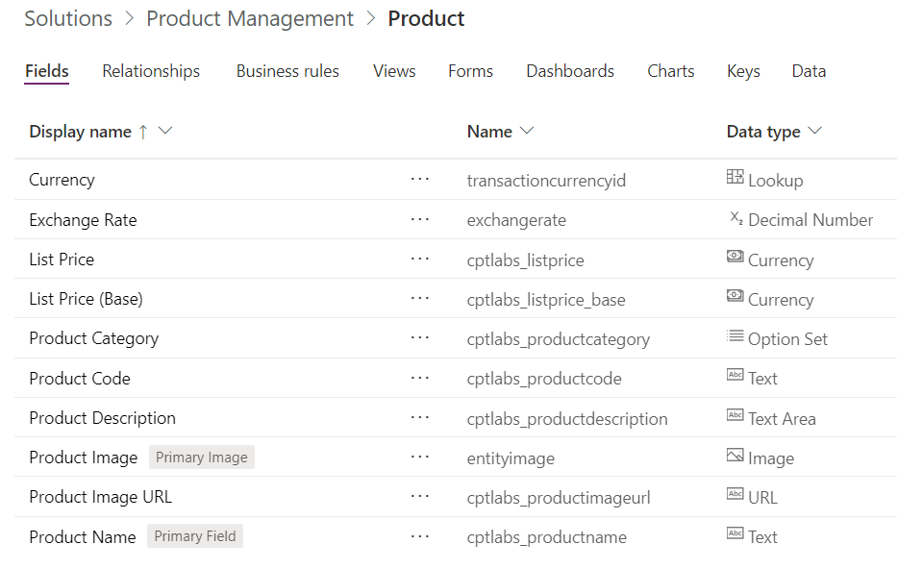
Adding Custom Fields

Slide 40
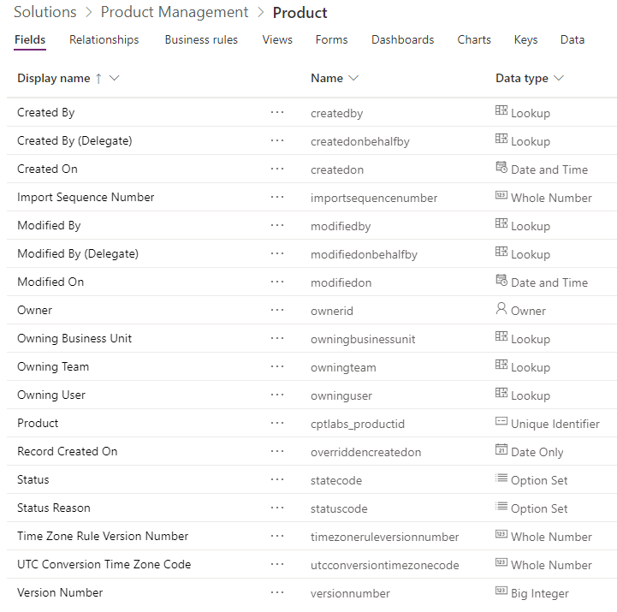
Core System Fields Added to All Entities
unique GUID-based identifier

Slide 41
Creating a CDS Entity

Slide 42
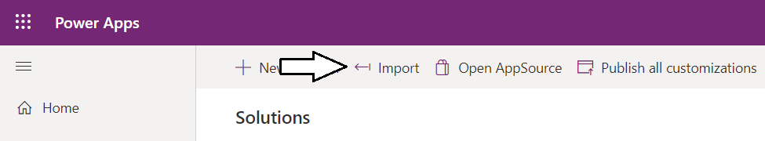
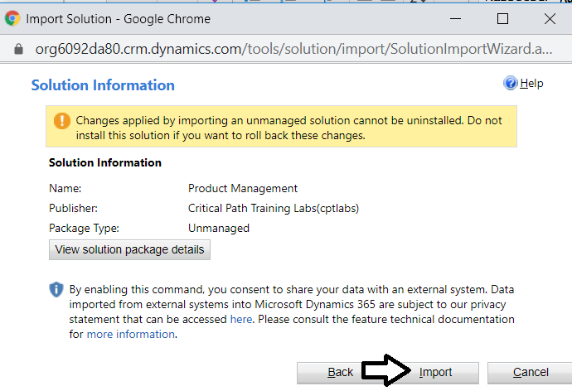
Importing Solutions
Click Import button in Solutions page
Select solution package file and run import command

Slide 43
Importing a CDS Solution

Slide 44
Agenda
Common Data Service Overview
Creating the CDS Database
Understanding Entities
Building Model-driven Apps
Developing with Solutions and Custom Entities
Importing Data into the CDS Database

Slide 45
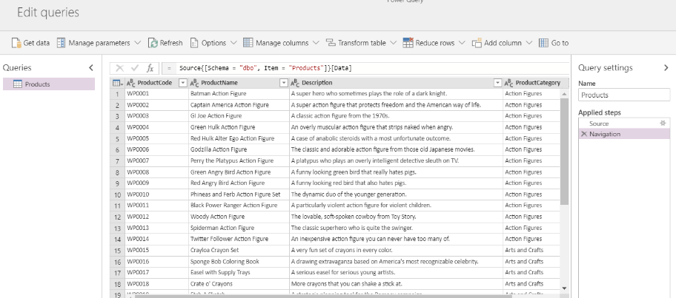
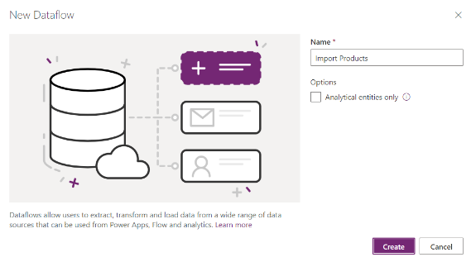
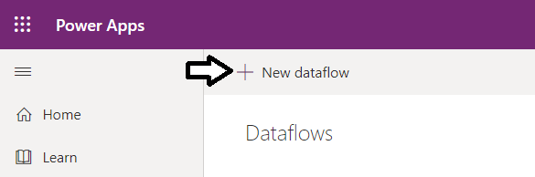
Importing Data using a Dataflow
You create dataflows to import data from external sources
Data can be added to table for new or existing entity
Dataflow tooling include Power Query UI in the browser

Slide 46
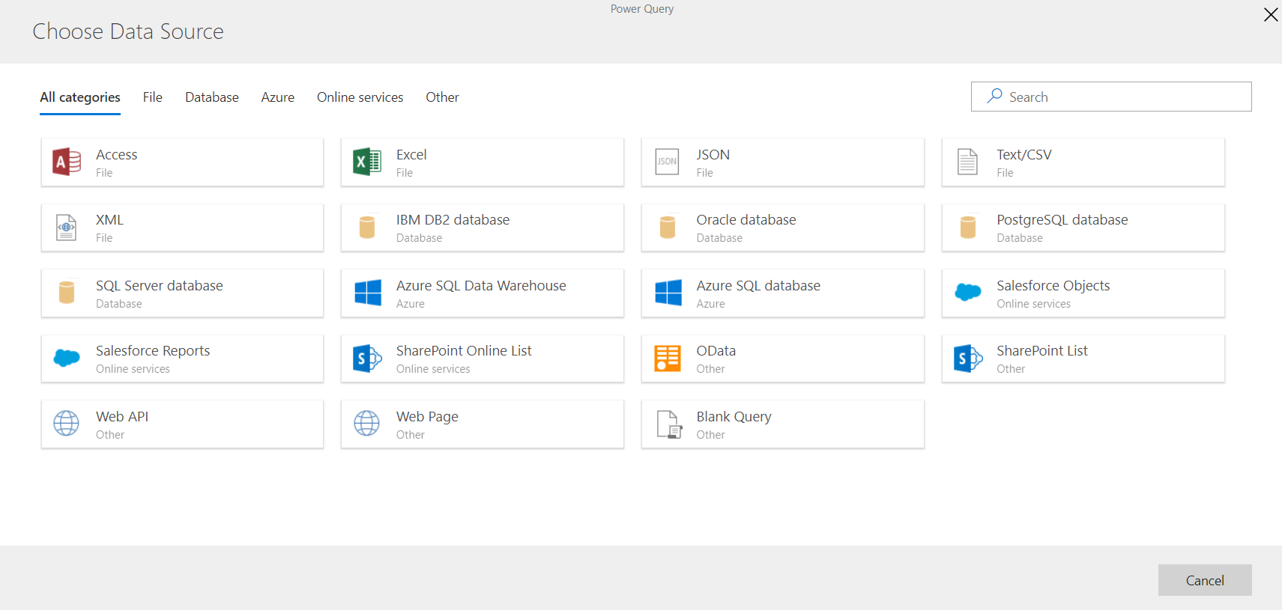
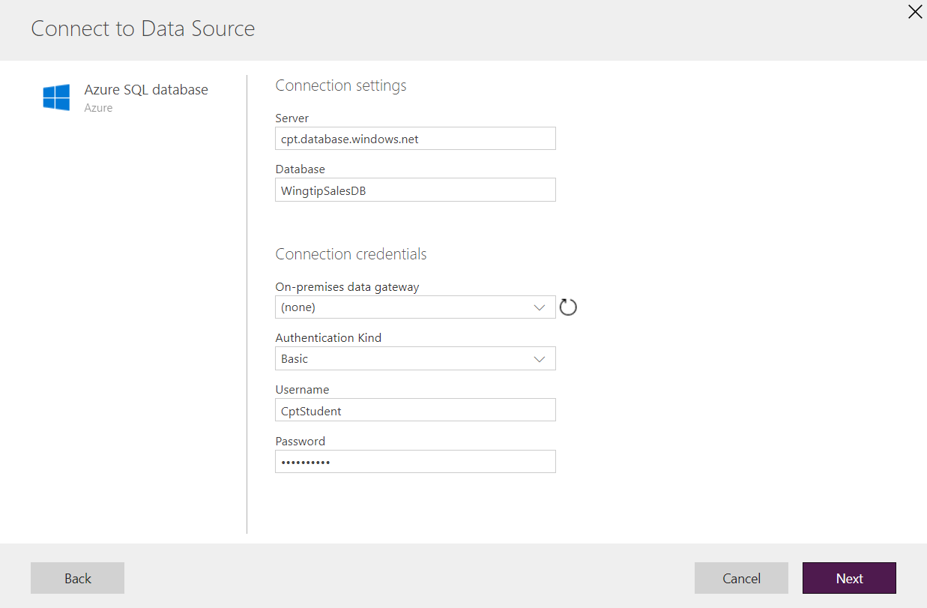
Selecting an External Datasource
Select a supported datasource connector

Slide 47
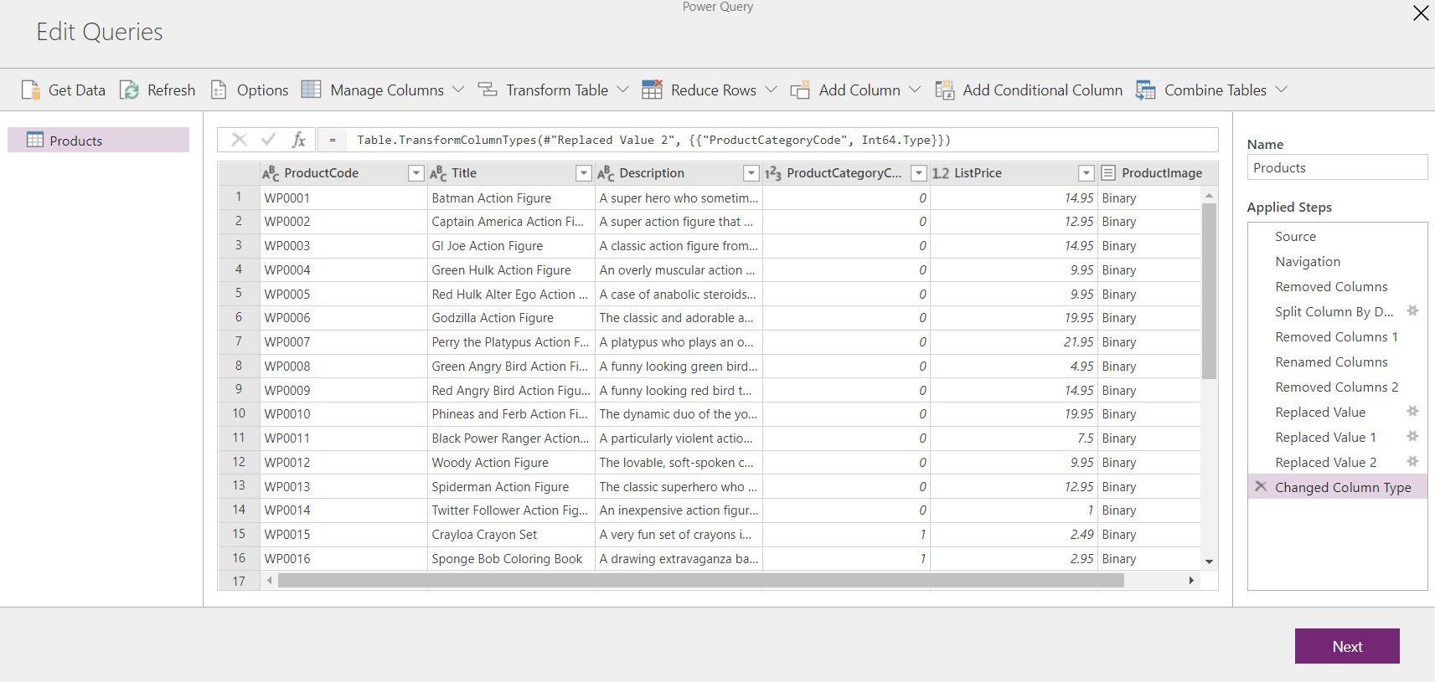
Power Query in the Browser

Slide 48
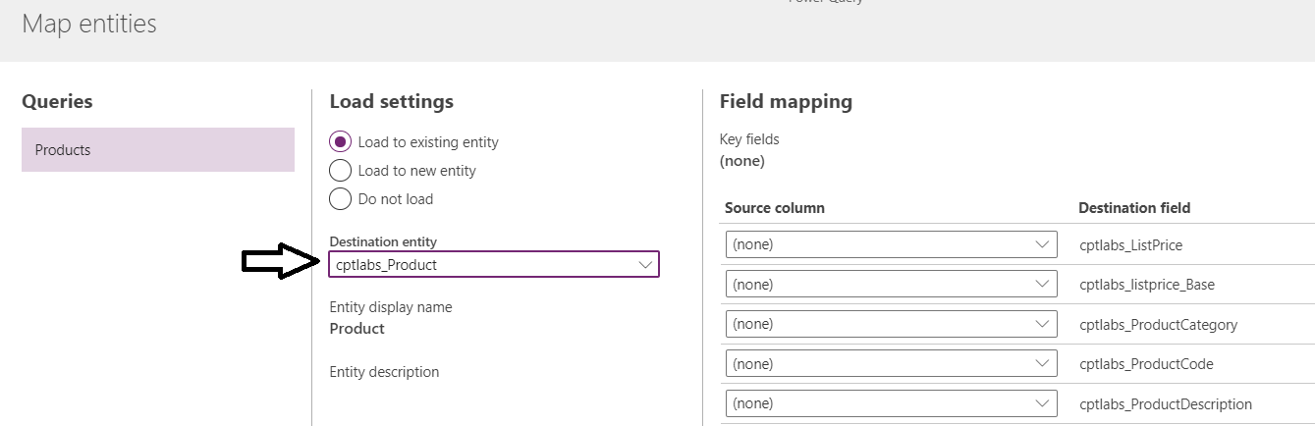
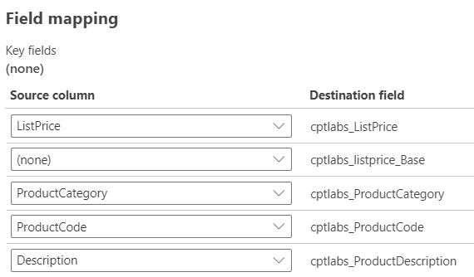
Loading Imported Data into Existing Entity

Slide 49
Importing Data into a CDS Entity

Slide 50
Summary
Common Data Service Overview
Creating the CDS Database
Understanding Entities
Building Model-driven Apps
Developing with Solutions and Custom Entities
Importing Data into the CDS Database

